Slide 1
Flavonoid Production Predictions
Fall 2020 Research Position Co-op with Dr. Moorman
Maggie Horton
18 December 2020

Slide 2
Outline
Background
Flavonoids
Flavonoid production
Plants of Interest
Flavonoids of Interest
Enzymes
Kyoto Encyclopedia of Genes and Genomes
Python
Project Overview
General Idea
Prior Progress
Code
Literature Search
Side project
What was learned
References

Slide 3
Background

Slide 4
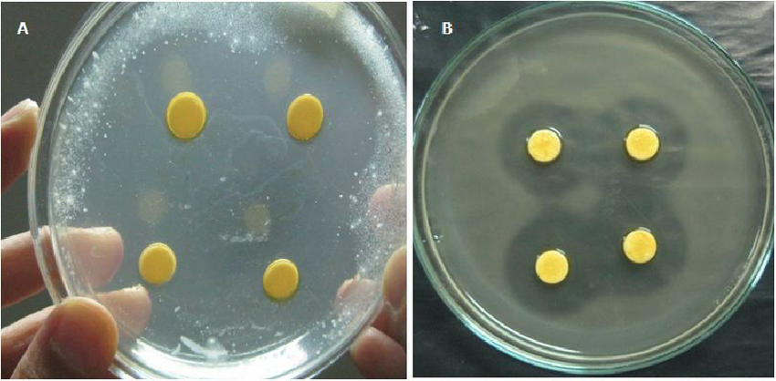
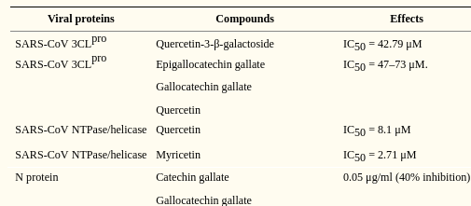
Flavonoids - Applications and Benefits
Health benefits (influenced by protein-flavonoid interactions)
Antioxidant, antiviral and antibacterial properties
Some reported to have cardiovascular protecting, anticancer, antiobesity and antidiabetic properties
Some shown to have antiinflammatory properties
Associated with lower cancer-related mortality
Involved in numerous studies
Interference with coronavirus
Breast cancer growth suppression
Cancer Chemopreventive Agents
Insect control in agriculture
Wide zone of bacterial inhibition attributed to quercetin derivatives along with other compounds
Amount of certain flavonoids needed to inhibit specific covid-19 proteins
Edited from source to focus on flavonoids of interest and their relatives

Slide 5

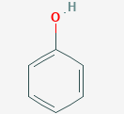
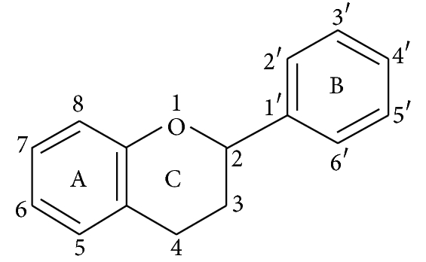
Flavonoids - Chemical Structure
Phytochemicals (produced by plants)
Polyphenolic
-OH group attached to a carbon from an aromatic ring
Commonly benzene-based, flat, cyclic atom structures
Shared basic structure based on 15-carbon skeleton (bonding pattern)
The A & B rings are phenolic
phenol (C₆H₅OH)
3D representation of a phenol ring
Basic flavonoid structure (aglycone)

Slide 6
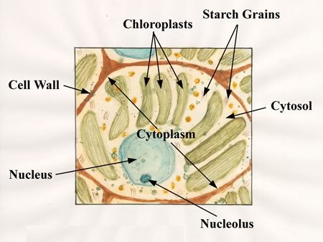
Flavonoid - Biology Overview
Secondary metabolites produced in cytosol
Beneficial but not necessary for survival
Formed through biosynthesis
Production of complex organic compounds using precursor compounds
Occurs in living organisms
Usually involves enzymes and an energy source
Purposes in plants
Provide flower pigmentation
Provide protection from insects & microbes
Act as UV filters
Provide drought resistance
Etc.

Slide 7
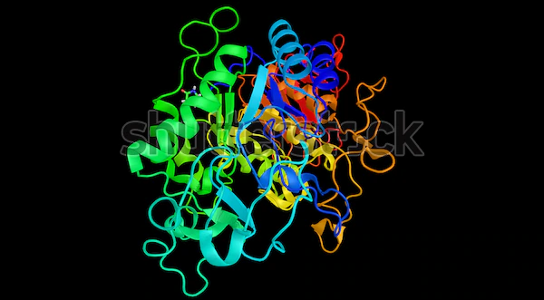
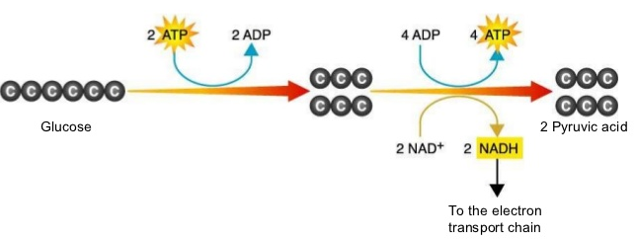
Enzymes, Biological Pathways & Flavonoid Production
Enzymes: proteins that accelerate chemical reactions
Pathways: chains of molecular interactions that result in the formation of new compounds or cell changes
Biosynthesis is a type of pathway that relies on enzymes
Flavonoid production is a specific type of biosynthesis that makes biological compounds
Amylase is a common enzyme that processes carbohydrates and starches into sugars and is found in saliva
Glycolysis (cellular respiration) is a very simple biological pathway

Slide 8
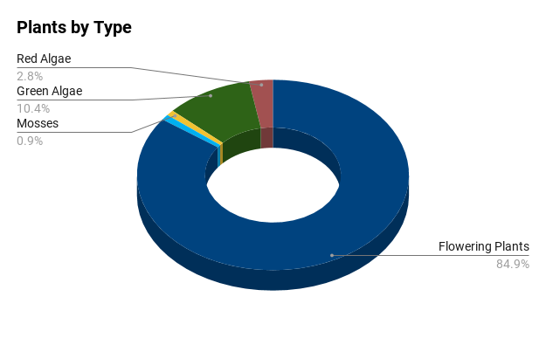
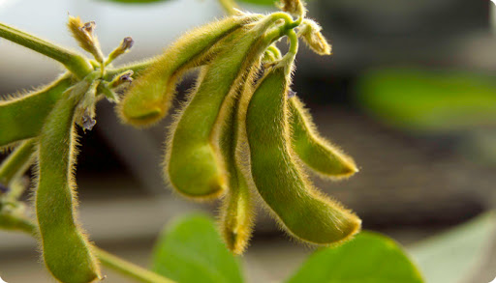
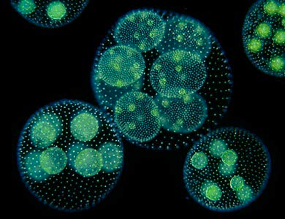
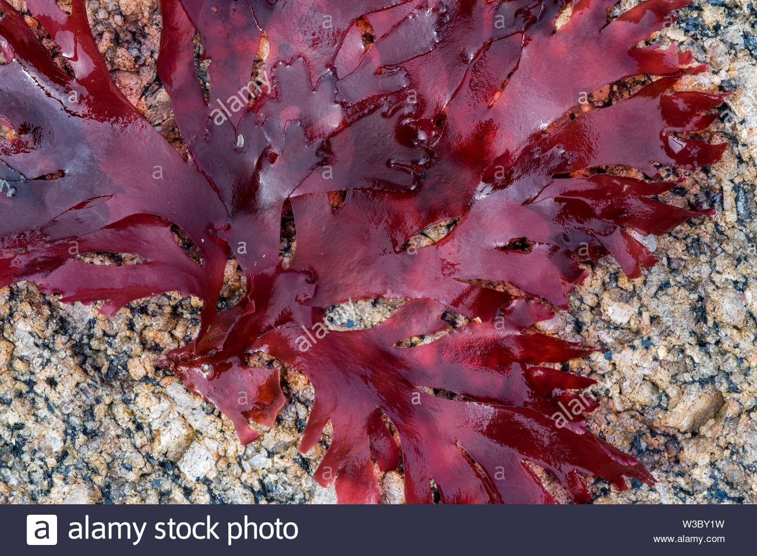
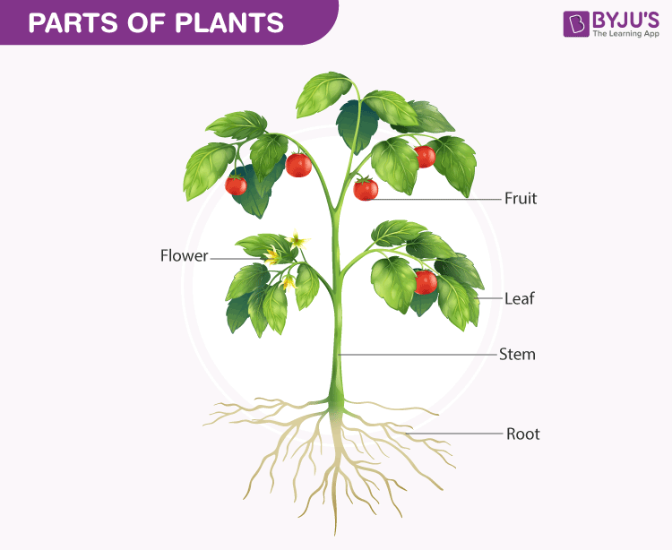
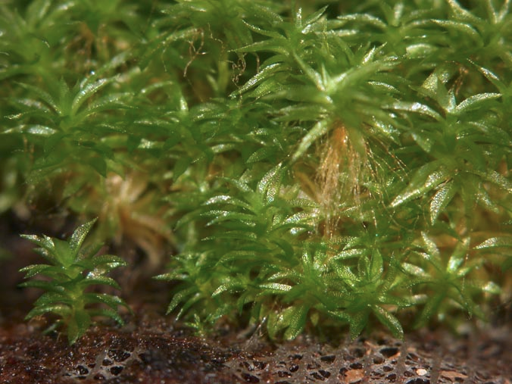
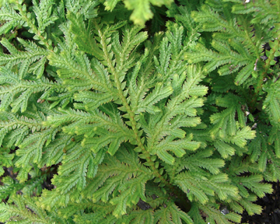
The Plants in Our Dataset
Work on the phylogenetic tree to put in this slide
Mostly flowering land plants
High rates of flavonoid production in flowers
Other species fall under the categories green algae, red algae, mosses and clubmosses
Flavonoid production occurs in most parts of a plant
Selected due to easy access to information supplied by the Kyoto Encyclopedia of Genes and Genomes (KEGG)
Distribution of the plant classifications
Soybean (Flowering plant)
Volvox carteri (Green algae)
Irish Moss (Red algae)
Spreading Earthmoss (Moss)
Spikemoss (Clubmoss)
Simple diagram of a flowering land plant

Slide 9
Kyoto Encyclopedia of Genes & Genomes (KEGG)
Provides data relating to different biological processes, including:
Taxonomic classifications
Genes
Enzymes
Reactions
Compounds
Biosynthesis pathway maps
Fully sequenced and annotated genomes

Slide 10
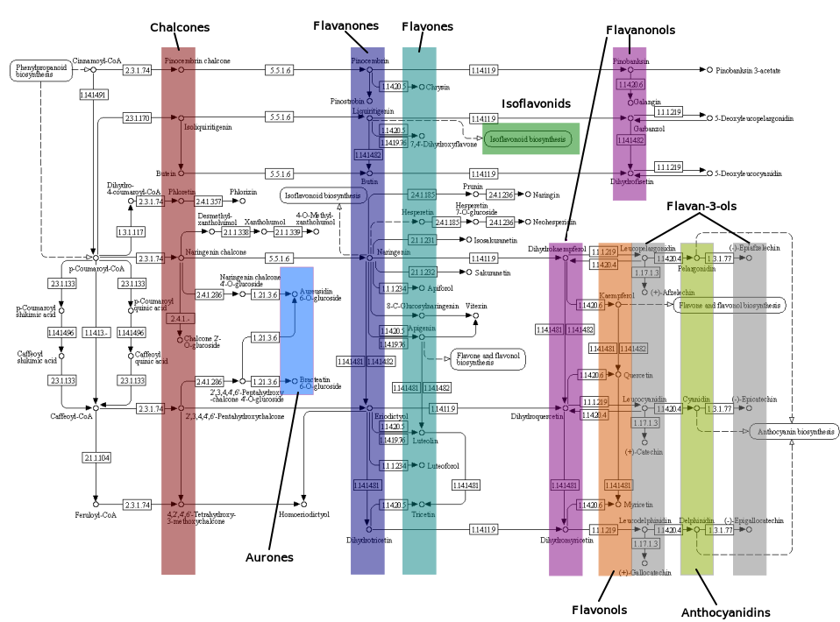
KEGG’s Reference Flavonoid Biosynthesis Map

Slide 11
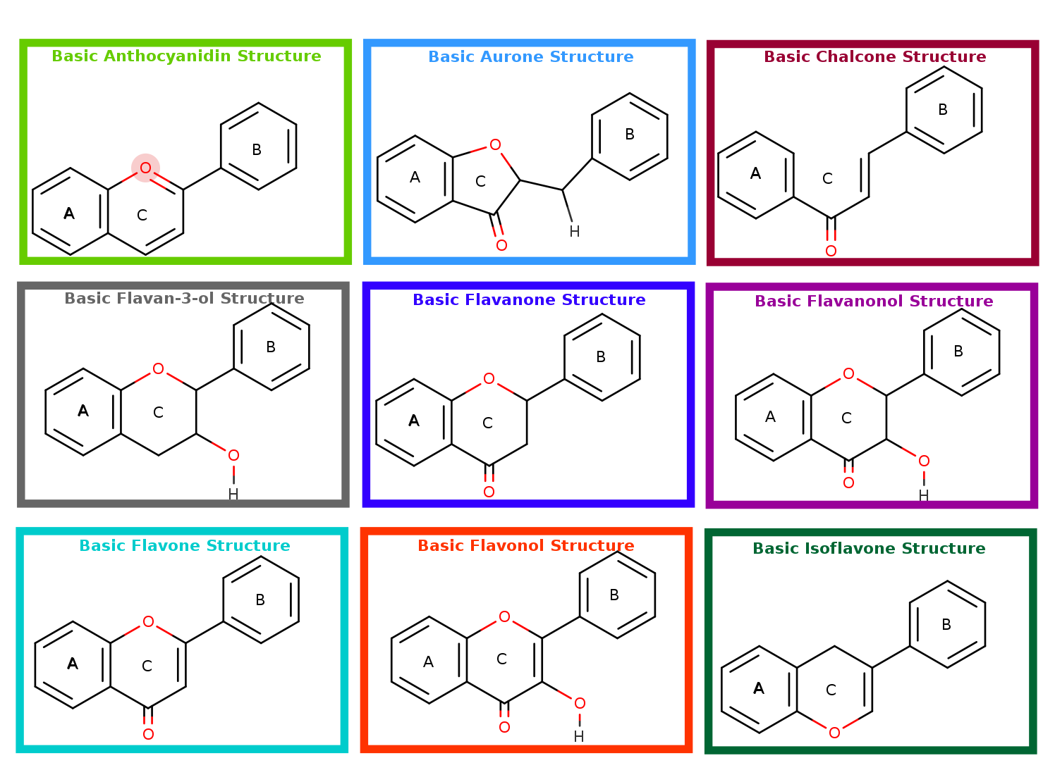
Flavonoids in Our Dataset & Flavonoid Classes
Anthocyanidins
Cyanidin
Chalcones
Butein & Isoliquiritigenin
Flavan-3-ols
Catechin, Epicatechin, Epigallocatechin & Gallocatechin
Flavanones
Eriodictyol & Naringenin
Flavones
Apigenin & Luteolin
Flavonols
Kaempferol, Myricetin & Quercetin
Isoflavonoids
Genistein

Slide 12
Project Overview

Slide 13
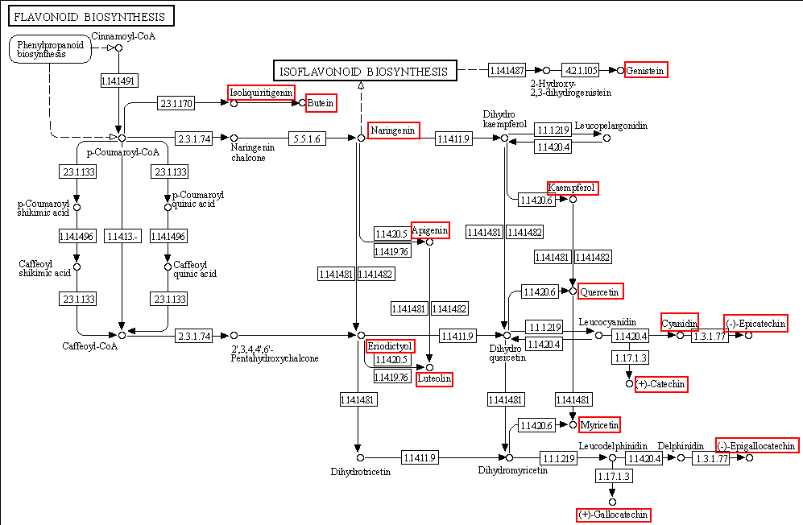
General Idea
The main goal is to make predictions on which of the flavonoids of interest each plant could produce
Made using data from KEGG & are theoretical
Continuation of a former student’s thesis project
Two main components to the current progress
Work on code used in making the predictions
Conduct literature & database searches on plants experimentally known to produce flavonoids
Simplified combined map of flavonoid & isoflavonoid biosynthesis, highlighting flavonoids of interest, taken from Kyoto Encyclopedia of Genes & Genomes (KEGG)

Slide 14
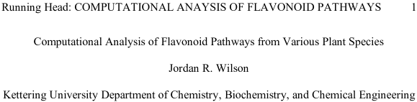
Prior Progress
Continuation of the progress made from former student Jordan Wilson’s thesis project
Written in Python 2 (now unsupported)
Libraries no longer developed
Division rounds down (ex: 5/2 = 2)
Slightly different syntax (causes errors)
Unsystematic literature search
Information from databases is now listed under each source
Focused on making predictions for only four flavonoids: Catechin, Epicatechin, Eriodictyol and Naringenin
Now makes predictions for 15 different flavonoids

Slide 15

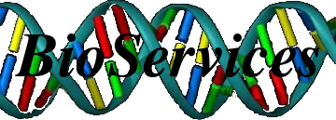

Python
Main language used in project
Multi-purpose programming language
Beginner-friendly.
Popular in natural sciences
Many chemistry and biology libraries available
Bioservices provides access to the data from KEGG

Slide 16
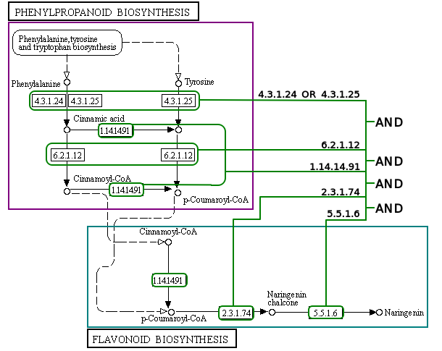
Python Code
Predict which flavonoids can be produced by each plant
Found requirements made of different enzymes
Determined if each plant satisfies requirements
EC requirements for Naringenin based on KEGG maps

Slide 17
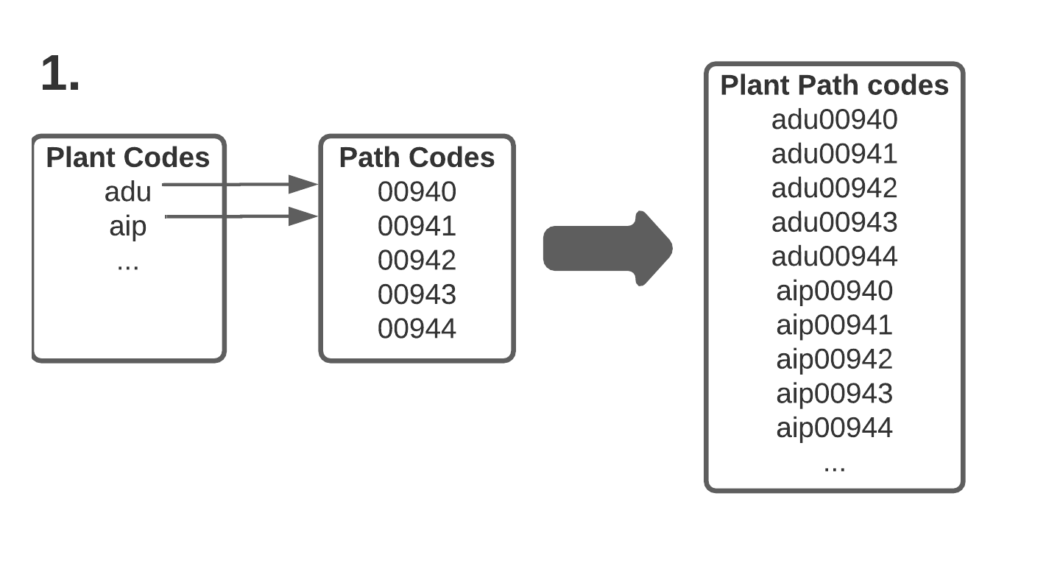
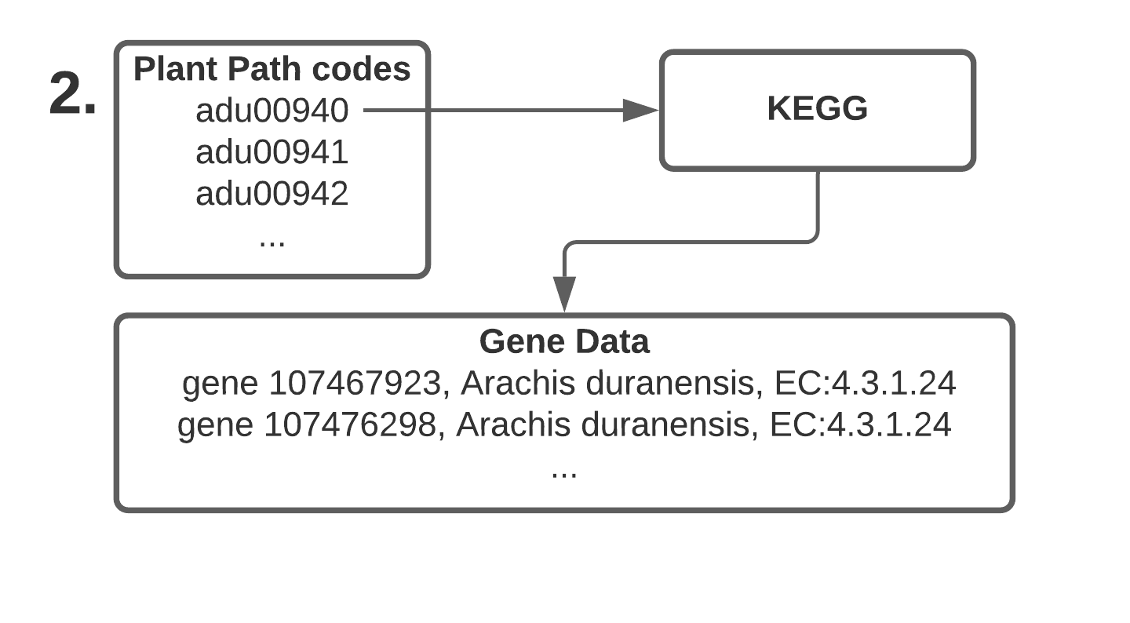
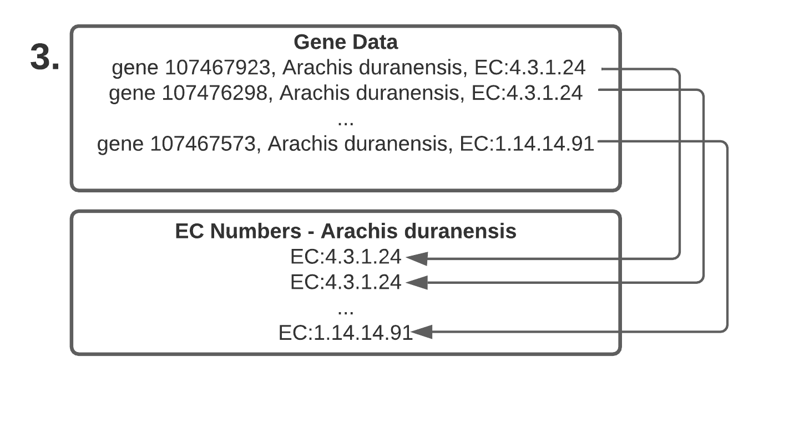
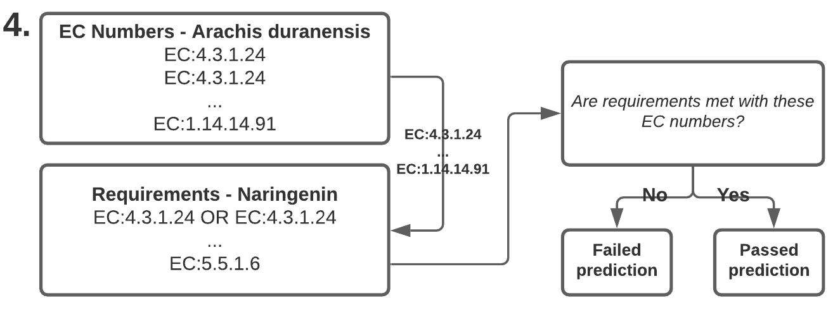
Code Overview
Make list of pathways from map and plant codes
Get gene entries for pathways
Save each plant’s EC numbers from gene entries
Make predictions based on each plant’s EC numbers
Count occurence of each EC number per plant
Get NT sequence data for each EC number in FASTA format

Slide 18
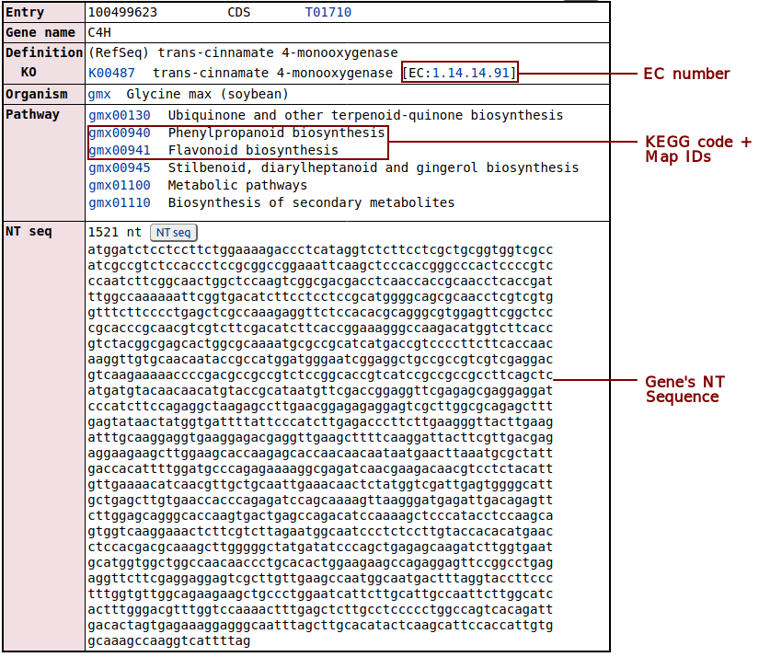
KEGG Data
Data used in program:
Pathway map and plant codes
Used in finding genes
Ex: gmx00941 = info for Glycine max in flavonoid biosynthesis (map 00941)
Gene entries
Enzyme Commission (EC) numbers
Enzyme classification scheme
FASTA data - Nucleotide (NT) sequences
Formatted sequences
To be used in future project relating to evolution of flavonoid production
Part of the KEGG entry for Glycine max, gene 100499623

Slide 19
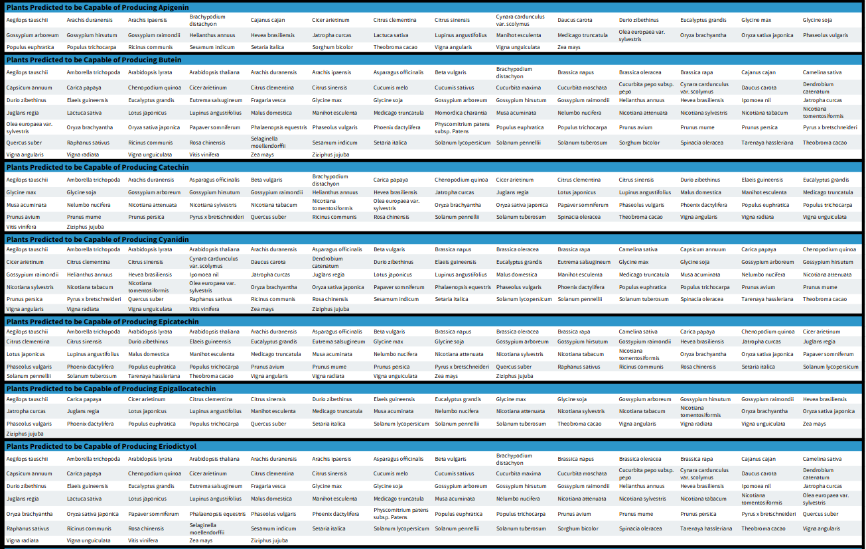
Prediction Results

Slide 20
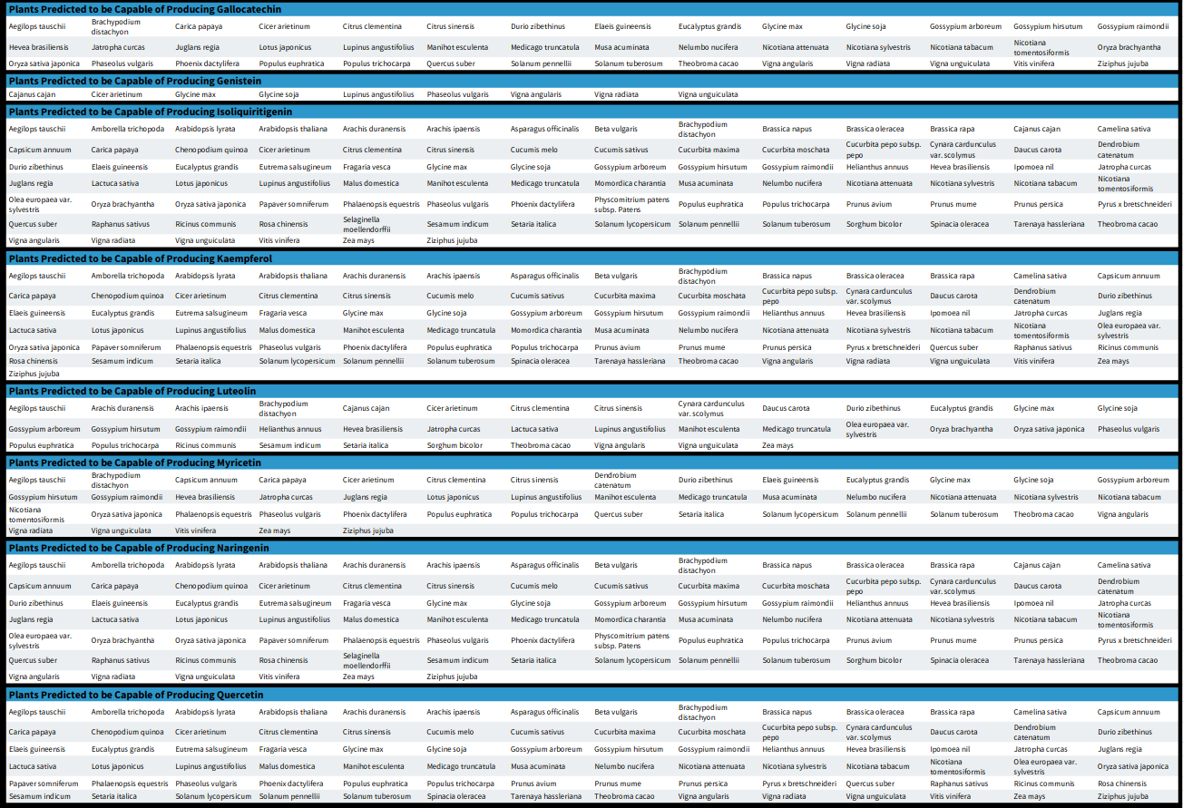
Prediction Results

Slide 21
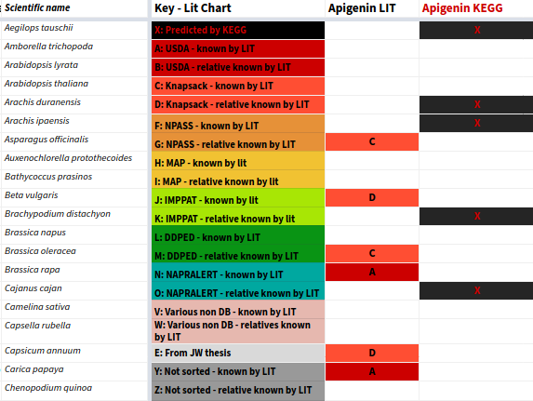
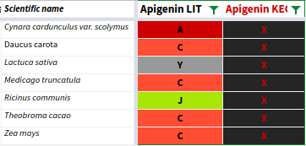
Literature & Database Search
Compare predictions to known results
Necessary to have a reference since some predictions appear unlikely
Search through large datasets manually & programmatically
USDA
KNApSAcK
Natural product activity & species source database (NPASS)
Microbiome Analysis for Patients (MAP)
Indian Medicinal Plants, Phytochemistry And Therapeutics (IMPPAT)
Dr. Duke's Phytochemical and Ethnobotanical Databases (DUKE)
Look at results in papers, journals, etc.
Compare the matches and missing data between different sources
Sources have varied focuses resulting in different data
Literature search spreadsheet key
Plants experimentally known and predicted to produce Apigenin

Slide 22
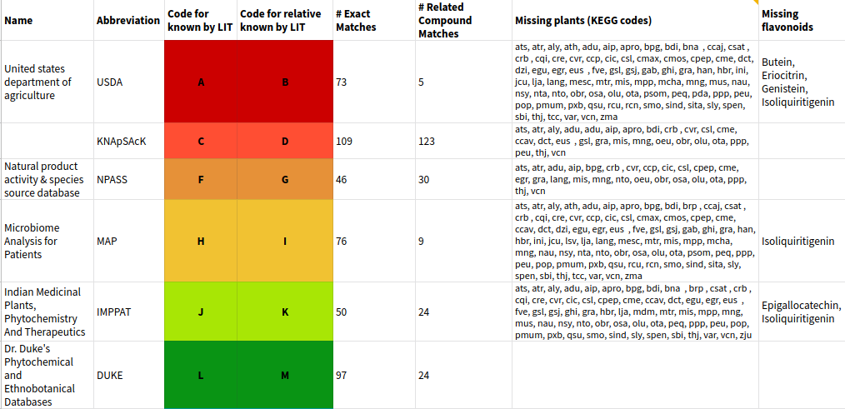
Literature & Database Search

Slide 23
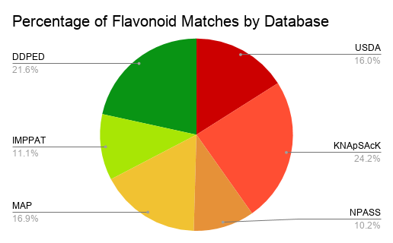
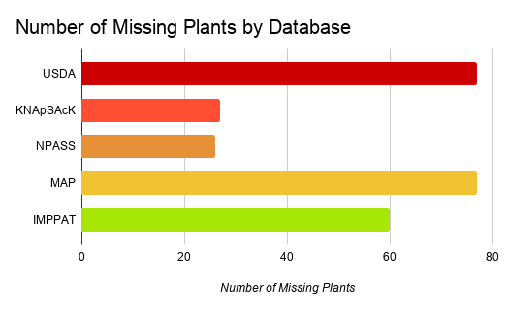
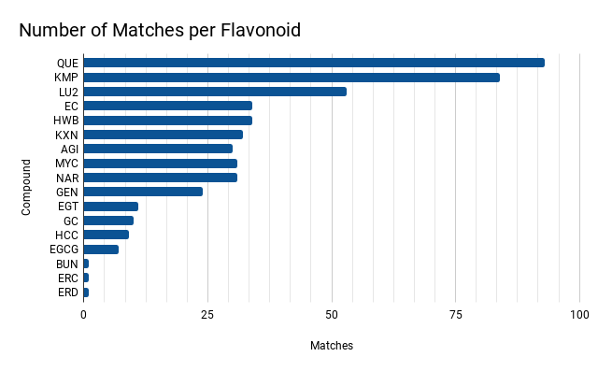
Literature & Database Search - Results
Knapsack provided the greatest number of matches while NPASS provided the fewest
USDA was missing data for the greatest number of plants
Quercetin (QUE) ended up with the greatest number of results, while Butein (BUN), Eriocitrin (ERC) & Eriodictyol (ERD) had one result each

Slide 24
Future Work
Add more databases and points of comparison
Map KEGG predictions and results from literature & database search onto phylogenetic tree
Expand flavonoid dataset
Determine if there are any exceptions in pathway maps in order to increase KEGG prediction accuracy
Set up the program such that prediction logic is read from a file and not hard-coded

Slide 25
Importance
Limited available data for certain flavonoids and plants
Bias in favor of edible and ethnobotanical/ethnomedical plants
Bias against algae species
Tool to be used in future research when determining which plants should be used
Literature search provides better idea of span of data from different sources

Slide 26
Side Project

Slide 27
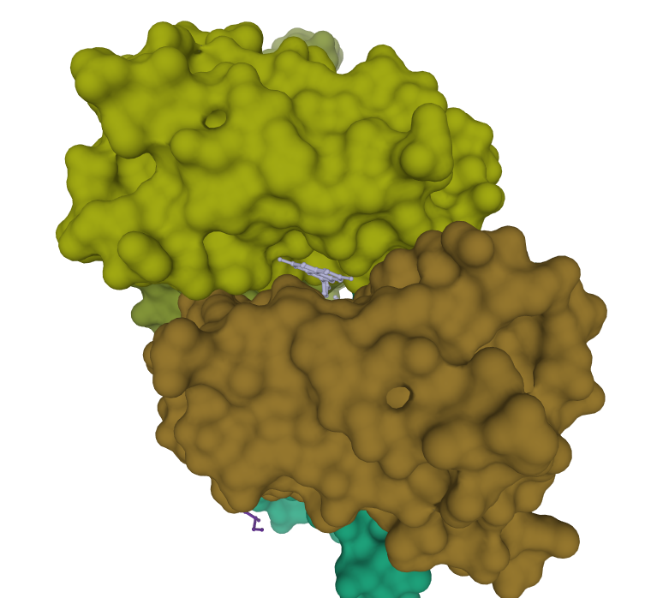
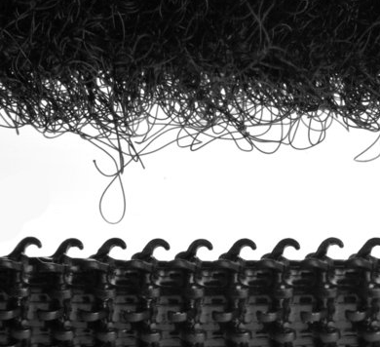
Characterizing Interactions Between Proteins & Flavonoids
Protein data comes from Protein Data Bank (PDB)
Current progress
Code parses PDB files, finds distance between atoms, finds angles between rings and finds any H atom within 1.2 angstroms of an O atom
Made code to run dr_sasa on many files
Calculates surface area of a molecule that is solvent-accessible
Important to find the amount of surface area that is accessible to flavonoids
Next steps
Compile list of enzymes that make the flavonoids that have structures in the PDB
Ties into main project
Importance
Could be used to create a reference database of interaction characterizations
4DER: Crystal Structure of the Wild Type TTR Binding Apigenin
Just like with velcro, the amount of available surface area affects the binding process

Slide 28
What Was Learned
Familiarity with databases
KEGG
PDB
PubChem
Additional supplementary databases
Concepts and ideas
Biosynthesis, biological pathways & secondary metabolites
Importance of enzymes
Chemical rings
Proteins and their structures
Different chemical identifiers
Programming
How to use regular expressions for easier file parsing
How to use REST (REpresentational State Transfer) APIs (Application programming interface) to retrieve compound information
How to manipulate URLs to download and parse information from websites
Relationship between biochemistry & computer science
Code is an extremely beneficial tool in furthering studies

Slide 29
Acknowledgements
Dr. Moorman
Dr. Rabago-Smith
Dr. Cohen
Abigail Hadden
Jordan Wilson
Jinny L. Shows
Kiah S. Lowe
Dr. Moorman’s Start-up Funds
Provost Matching Funds

Slide 30
References - Information
“Kyoto Encyclopedia of Genes and Genomes.” KEGG, Kanehisa Laboratories, www.kegg.jp/.
Panche, A. N., Diwan, A. D., & Chandra, S. R. (2016). Flavonoids: an overview. Journal of nutritional science, 5, e47. https://doi.org/10.1017/jns.2016.41
Samanta, Amalesh & Das, Gouranga & Das, Sanjoy. (2011). Roles of flavonoids in Plants. International Journal of pharmaceutical science and technology. 6. 12-35.
Zhang, Yang. “What Is FASTA Format?” Zhang Lab, University of Michigan, zhanglab.ccmb.med.umich.edu/FASTA/.
Szalay, Jessie. “What Is Protein?” LiveScience, Purch, 10 Dec. 2015, www.livescience.com/53044-protein.html.
Helen M. Berman, John Westbrook, Zukang Feng, Gary Gilliland, T. N. Bhat, Helge Weissig, Ilya N. Shindyalov, Philip E. Bourne, The Protein Data Bank, Nucleic Acids Research, Volume 28, Issue 1, 1 January 2000, Pages 235–242, https://doi.org/10.1093/nar/28.1.235
Ribeiro, J., Ríos-Vera, C., Melo, F. and Schüller, A. (2018) “Calculation of accurate contact surface areas between atoms for the quantitative analysis of non-bonded molecular interactions”. Bioinformatics (submitted).
Corradini E, Foglia P, Giansanti P, Gubbiotti R, Samperi R, Lagana A. Flavonoids: chemical properties and analytical methodologies of identification and quantitation in foods and plants. Nat Prod Res. 2011 Mar;25(5):469-95. doi: 10.1080/14786419.2010.482054. PMID: 21391112.
Kozłowska A, Szostak-Wegierek D. Flavonoids--food sources and health benefits. Rocz Panstw Zakl Hig. 2014;65(2):79-85. PMID: 25272572.
Cíntia Reis Ballard, Mário Roberto Maróstica, Chapter 10 - Health Benefits of Flavonoids, Editor(s): Maira Rubi Segura Campos, Bioactive Compounds, Woodhead Publishing, 2019, Pages 185-201, ISBN 9780128147740, https://doi.org/10.1016/B978-0-12-814774-0.00010-4.(http://www.sciencedirect.com/science/article/pii/B9780128147740000104)
Bondonno, N.P., Dalgaard, F., Kyrø, C. et al. Flavonoid intake is associated with lower mortality in the Danish Diet Cancer and Health Cohort. Nat Commun 10, 3651 (2019). https://doi.org/10.1038/s41467-019-11622-x
Russo, M., Moccia, S., Spagnuolo, C., Tedesco, I., & Russo, G. L. (2020). Roles of flavonoids against coronavirus infection. Chemico-biological interactions, 328, 109211. https://doi.org/10.1016/j.cbi.2020.109211
Rodríguez-García, C., Sánchez-Quesada, C., & J Gaforio, J. (2019). Dietary Flavonoids as Cancer Chemopreventive Agents: An Updated Review of Human Studies. Antioxidants (Basel, Switzerland), 8(5), 137. https://doi.org/10.3390/antiox8050137
Lacuna, Maria Lourdes Dorothy. (2013). Antimicrobial activity of supercritical fluid extracts of two Philippine medicinal plants, Psidium guajava and Euphorbia hirta: Implications to community health. AAB BIOFLUX. 5. 1-12.
Maria Lourdes Pérez-Chabela, Annel M. Hernández-Alcántara, Chapter 8 - Agroindustrial Coproducts as Sources of Novel Functional Ingredients, Editor(s): Alexandru Mihai Grumezescu, Alina Maria Holban, In Handbook of Food Bioengineering, Food Processing for Increased Quality and Consumption, Academic Press, 2018, Pages 219-250, ISBN 9780128114476, https://doi.org/10.1016/B978-0-12-811447-6.00008-4.(http://www.sciencedirect.com/science/article/pii/B9780128114476000084)
Banoth RK and Thatikonda A: A review on natural chalcones an update. Int J Pharm Sci & Res 2020; 11(3): 546-55. doi: 10.13040/ IJPSR.0975-8232.11(3).546-55.
“Biosynthesis Definition and Examples - Biology Online Dictionary.” Biology Articles, Tutorials &amp; Dictionary Online, BiologyOnline, 26 Jan. 2020, www.biologyonline.com/dictionary/biosynthesis.
“Phenol.” Encyclopædia Britannica, Encyclopædia Britannica, Inc., www.britannica.com/science/phenol.
“Phenol.” National Center for Biotechnology Information. PubChem Compound Database, U.S. National Library of Medicine, pubchem.ncbi.nlm.nih.gov/compound/Phenol.

Slide 31
References - Images
Gribskov. “Selaginella Moellendorffii.” File:Smo2-72.Jpg, Wikimedia Commons, 2007, commons.wikimedia.org/wiki/File:Smo2-72.jpg.
Mfiegl. “Volvox Carteri.” File:Vc.jpg, Microbewiki, 14 Apr. 2018, microbewiki.kenyon.edu/index.php/File:Vc.jpg.
“Glycine Max.jpg.” Glycine Max, GreeNC, 27 May 2020, greenc.sciencedesigners.com/wiki/Species:Glycine_max.
Philippe, Clement. Irish Moss / Carrageen Moss (Chondrus Crispus) Red Alga Washed Ashore on Rocky Beach, Alamy, 23 June 2019, www.alamy.com/irish-moss-carrageen-moss-chondrus-crispus-red-alga-washed-ashore-on-rocky-beach-image260262181.html.
Cokelaer, Thomas, et al. “_images/Bioservices.png.” BIOSERVICES: Access to Biological Web Services Programmatically, Thomas Cokelaer, Lea M. Harder, Jordi Serra-Musach, Dennis Pultz, 31 Oct. 2020, bioservices.readthedocs.io/en/master/.
Peterjc, et al., editors. “biopython_logo_white.Png.” Biopython, Biopython, 8 Oct. 2020, biopython.org/.
Kumar, Shashank, and Abhay K Pandey. “162750.Fig.001.Jpg.” Chemistry and Biological Activities of Flavonoids: An Overview, Hindawi, 29 Dec. 2013, www.hindawi.com/journals/tswj/2013/162750/.
“Cell.jpg.” Plant Life, Blogger.com, May 2011, lifeofplant.blogspot.com/2011/05/cytosol.html.
“Figure 3” .Antimicrobial activity of supercritical fluid extracts of two Philippine medicinal plants, Psidium guajava and Euphorbia hirta: Implications to community health - Scientific Figure on ResearchGate. Available from: https://www.researchgate.net/figure/Antimicrobial-assay-plate-for-the-antibacterial-activity-of-P-guajava-on-the-growth-of_fig3_240448749 [accessed 17 Dec, 2020]
“2D Structure.” Phenol, National Library of Medicine, pubchem.ncbi.nlm.nih.gov/compound/996.
“3D Conformer.” Phenol, Pubchem, pubchem.ncbi.nlm.nih.gov/compound/996#section=Structures.
Andras, Samuel. “PSF-Logo-1.Png.” A Few Things About the Python Foundation, Evozon Systems, 20 Mar. 2018, www.evozon.com/blog/python-software-foundation.
Ibreakstock. “Amylase Protein (3d Structure). Digestive Enzyme, Responsible for the Hydrolysis of Starch into Sugars. Found in Saliva.” Amylase Protein (3d Structure). Digestive Enzyme, Responsible for the Hydrolysis of Starch into Sugars. Found in Saliva., Shutterstock, www.shutterstock.com/image-illustration/amylase-protein-3d-structure-digestive-enzyme-564989863.
“Parts-of-Plants.png.” Parts Of Plants, BYJU'S, byjus.com/biology/parts-of-plants/.
Pirex. “Physcomitrella.jpg .” File:Physcomitrella.jpg, Wikimedia Commons, 4 Apr. 2007, commons.wikimedia.org/wiki/File:Physcomitrella.jpg.
Pointer, Karl. “Cellular-Respiration-8-728.Jpg.” Cellular Respiration , Slideshare, 23 Mar. 2011, www.slideshare.net/coachpointer/cellular-respiration-7359048.

Slide 32
Questions?

Slide 33

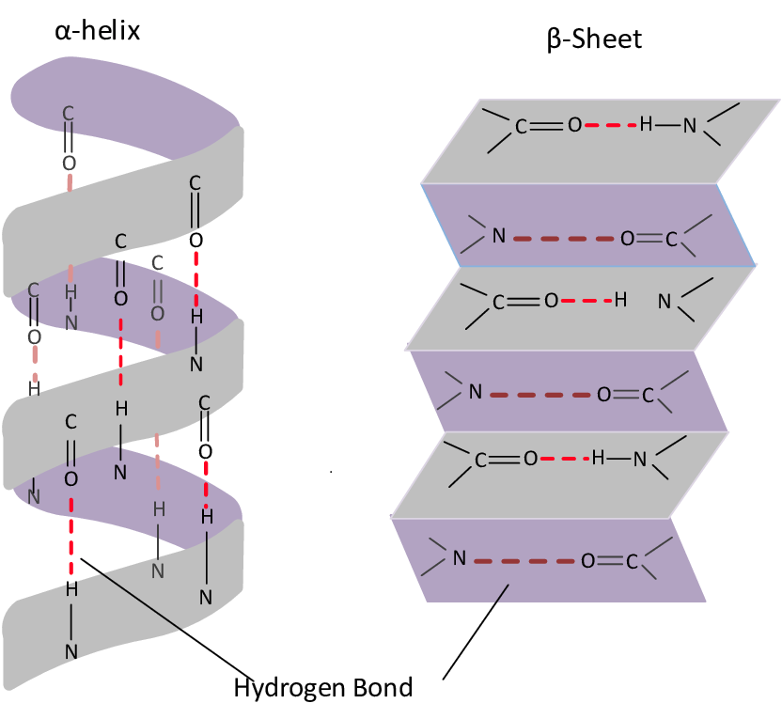
Proteins
Proteins are organic compounds that consist of at least one chain of amino acids.
Amino acids are organic compounds made of three core parts:
An amino (-NH₂) group
An acidic carboxyl group (-COOH)
A unique organic side chain (R group).
The order of amino acids determines how a protein will fold:
Alpha helices are coil-shaped.
Beta sheets take more of a folded shape, like a piece of paper.
Folding allows for proteins to carry out their specific biological tasks.
That’s why prion diseases, which cause proteins to misfold, can be so harmful.
Keratin 5 & Keratin 14
Visual diagram of alpha helices & beta sheets

Slide 34
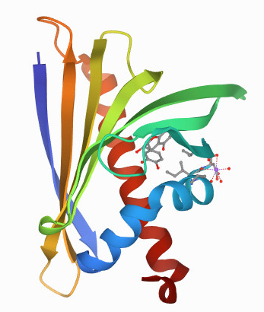
PDB
Provides information regarding proteins, including their 3D shapes and nucleic acids.
The information for most proteins can be found in a consistent PDB format, which is consistent and easy to parse.
They contain information such as the source organism and information regarding each atom, as can be seen in the file for structure 4MA6 (Crystal structure of Ara h 8 with Epicatechin bound):
SOURCE 3 ORGANISM_COMMON: GOOBER,GROUND-NUT;
ATOM 859 CA GLY A 110 -7.237 -13.703 8.734 1.00 43.31 C
3D structure 4MA6

Slide 35
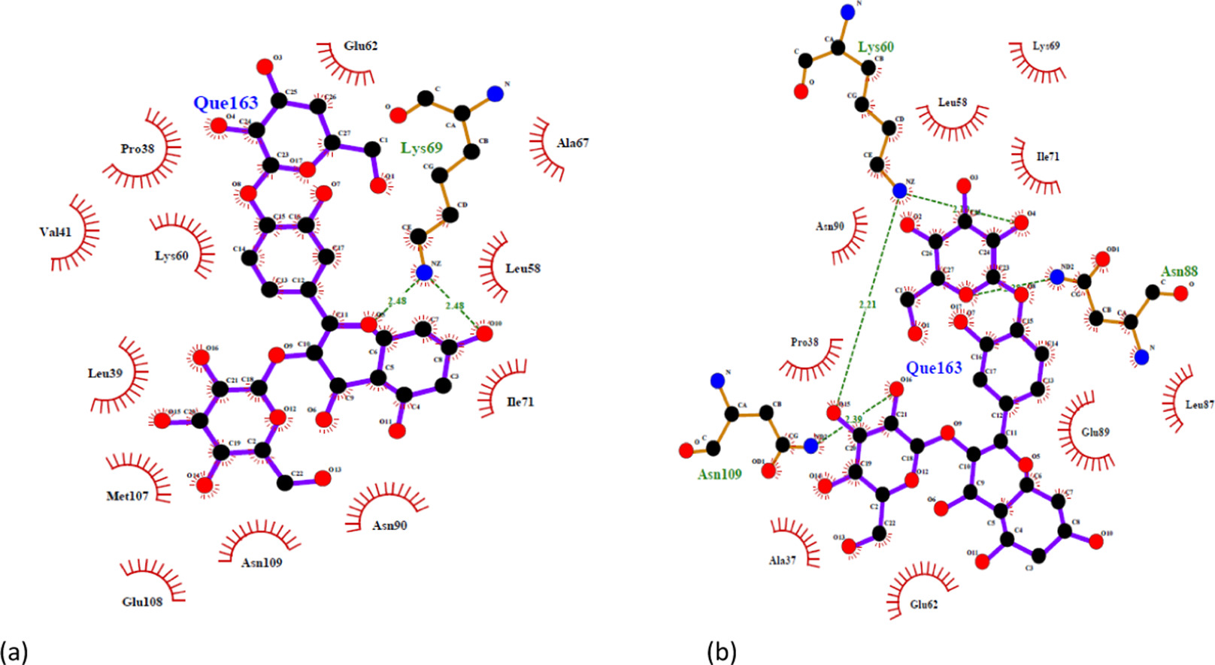
Project Overview
Focus on studying and characterizing interactions between proteins and flavonoids (or flavonoid-like compounds) when bound.
This project has much in common with my thesis project which focuses on flavonoid predictions.
Parts of the code from the prediction project may prove to be helpful references
This is important due to a low number of informational sources regarding these interactions.
“Atomic level details on the interaction between βLG molecules, equilibrated at 25 °C (a) and 100 °C (b) and quercetin-3,4′-O-diglucoside.”

Slide 36
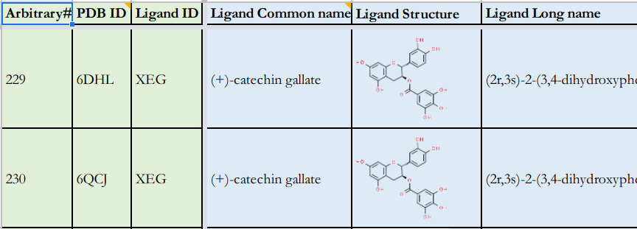
Data Set
The list of proteins that are being used are stored in a spreadsheet.
Contains several columns of information for each protein
These IDs have been converted to JSON files to be used in code
The information for each entry has been manually collected and will be used in programmatic applications
Most if not all information gathered from the Protein Data Bank
Screen shot from the PDB spreadsheet

Slide 37

Program
Currently, the program is only able to complete a limited set of tasks:
Download PDB files
Download mmCIF files if no PDB files are available, then convert to PDB
For each file, PDB entry attributes are saved and any ATOM/HETATM line containing ligands of interest are saved.
The program uses objects to hold the data in different properties or fields.
The portion of the code that downloads the files, converts (if necessary) and makes calls to parse and save data.

Slide 38
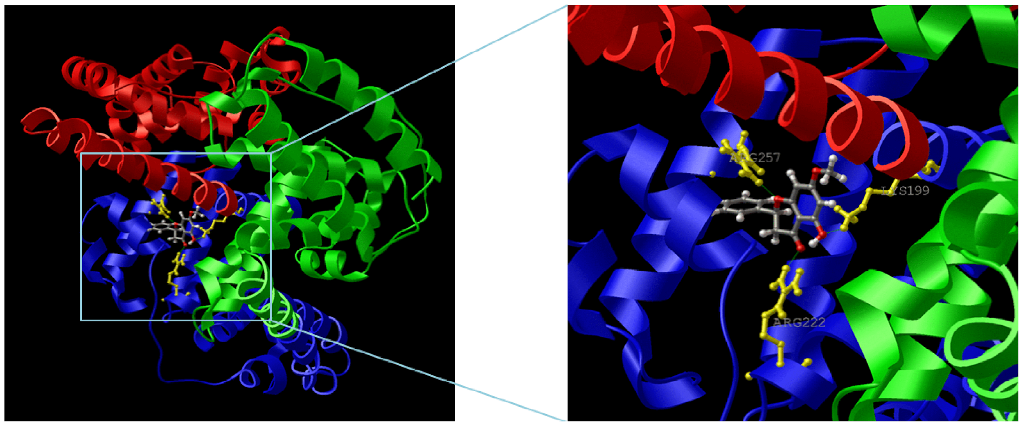

Importance
If implemented successfully, the output could be used to create a database of interaction characterizations for use in further studies and research.
For example, some research projects have focused on how the antioxidant properties of flavonoids change when interacting with proteins. This type of information could prove very useful for these types of project
Large (reference) data sets are always very helpful in designing experiments and conducting research.

Slide 39
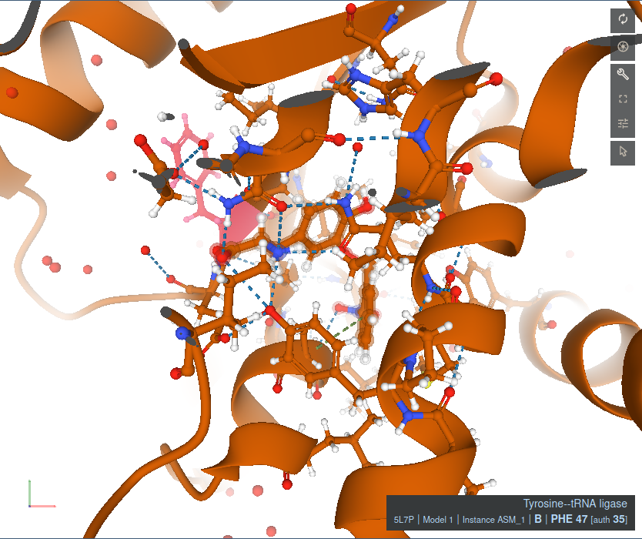
Next Steps
The aim is to be able to use the coordinate values for each atom in the characterization process
The program will most likely implement other methods for characterizing these interactions.
Screenshot taken from PDB for structure 5L7P in the ligand interaction viewing tool

